Slide 1

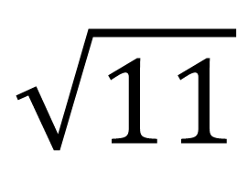


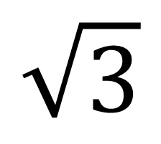

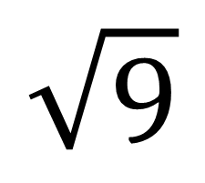


My Index, Surd & Log Interactive Notebook
$$×$$
$$\sqrt{3}$$
$$÷$$
$$+$$
$$\sqrt{11}$$
$$−$$
$$π$$
Name
Class
Teacher
Term 1 Semester 1
$$5^{2}$$
$$\sqrt{9}$$
1

Slide 2
Contents
Glossary or Formula Page
Page
Date
Description
2
3

Slide 3
Tasks
24
7
30
Essential Question
Questions
Notes
Summary
6
7

Slide 4
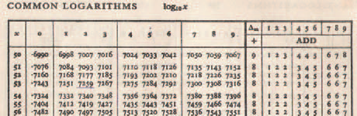
24
7
30
Date
Number system and logs
EQ – How do I find or use the log of a number?
How would you multiply numbers?
Eg. 6.973 x 4.748 ÷ 7.386
We would find the log of the numbers and then add and subtract these (exactly like indices) and then find the anti-log
Easy isn’t it. And no you don’t have to do that for this course, calculators do that for you.
7

Slide 5
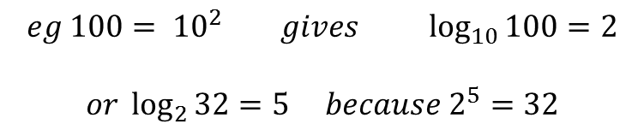
24
7
30
Date
Number system and logs
EQ – How do I find or use the log of a number?
Logarithms
The logarithm to the base b of the number x, where b and x are positive and b ≠ 1, is the solution of the equation b^{y} = x. It is written as y = log_{b}x and is the power to which b must be raised to produce the number x.
But what is a log?
$$eg 100= {10}^{2} gives \log_{10}{100=2}$$
$$or \log_{2}{32=5 because 2^{5}=32}$$
Index base
To this power
Equals this number
7

Slide 6
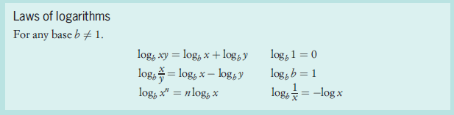
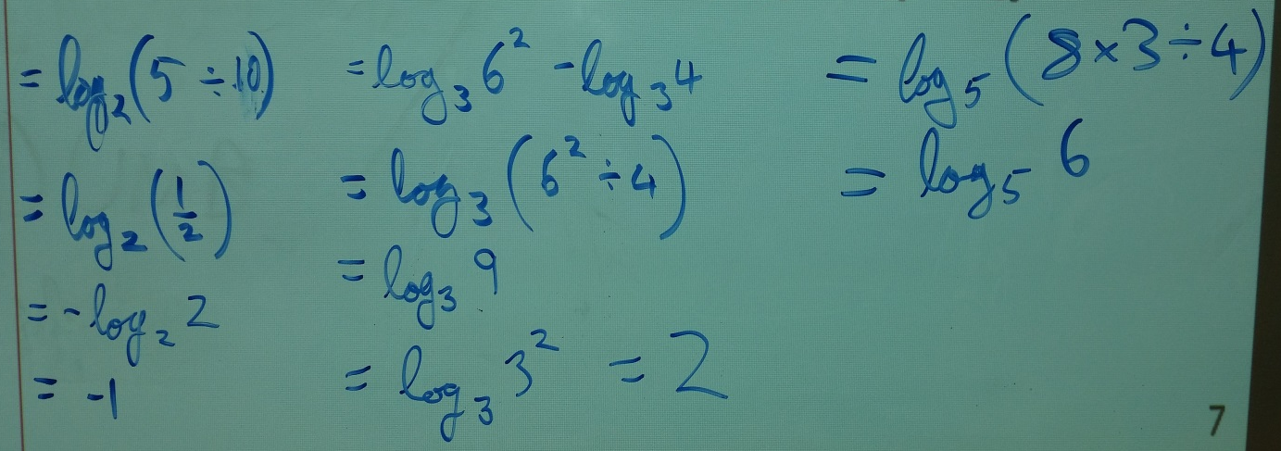
24
7
30
Date
Number system and logs
EQ – How do I find or use the log of a number?
Log laws – very similar to log laws
Simplify each of the following expressions.
a) log₂5 - log₂10 b) 2log₃6 – log₃4 c) log₅8 + log₅3 - log₅4
7

Slide 7
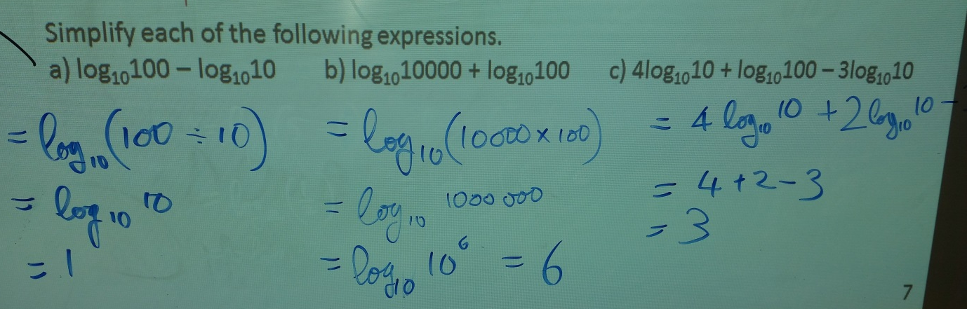
24
7
30
Date
Number system and logs
EQ – How do I find or use the log of a number?
Log laws – very similar to log laws
- And if I am using base 10
Simplify each of the following expressions.
a) log₁₀100 – log₁₀10 b) log₁₀10000 + log₁₀100 c) 4log₁₀10 + log₁₀100 – 3log₁₀10
7

Slide 8
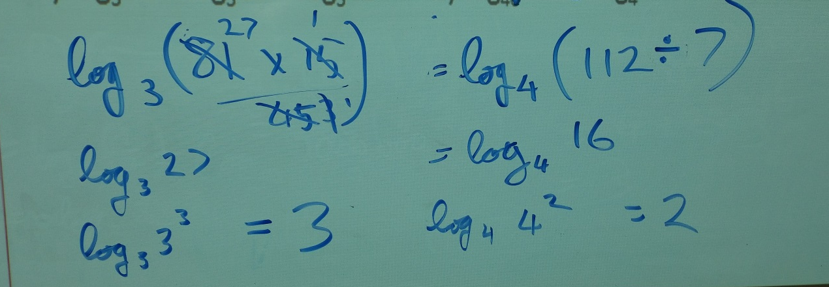
24
7
30
Date
Number system and surds
EQ – How do I find or use the log of a number?
Log laws – very similar to log laws
- And if I am using any base
Simplify each of the following expressions.
d) log₃81 + log₃15 – log₃45 b) log₄112 - log₄7
7

Slide 9
Exercises
Exercise 4.11 and 4.12 from Dwyer
Pages 54 & 55
All to be done with a smile on your faces.

Slide 10
Notes Review
24, 7 ,30
Date
Title
Essential question
Notes complete
Notes complete with colour and diagrams
Questions completed
Contents page filed in
Formula page filled in

Slide 11
Homework
Review your notes and write a summary answering the essential question.

